Slide 1

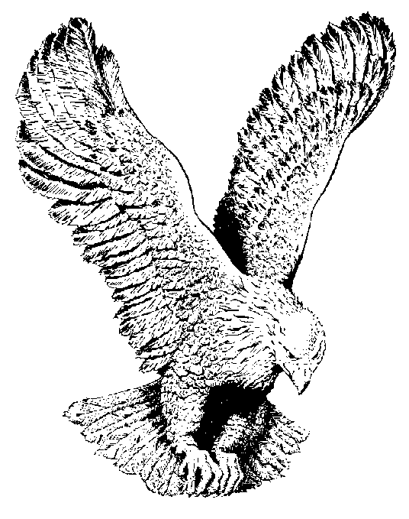
737 ‘NEATH THE OLD OLIVE TREES
‘Neath the stars of the night
Walked the Saviour of light
In the garden of dew—ladened breeze
Where no light could be found
Jesus knelt on the ground
There He prayed ‘neath the old olive trees.

Slide 2
CHORUS
‘Neath the old olive trees
‘Neath the old olive trees
Went the Saviour alone on His knees
“Not My will, Thine be done,”
Cried the Father’s own Son
As He knelt ‘neath the old olive trees.

Slide 3
All the sin of the world
On the Saviour was hurled—-
As He knelt in the garden alone
Hear His soul—burdened plea
Let This cup pass from Me
“Even so, not My will, Thine be done.”

Slide 4
May my song ever be
Of the love prof—fered me
By my Lord all alone on His knees
Praise His wonderful name
He who bore all my blame
As He knelt ‘neath the old olive trees.

